Slide 1
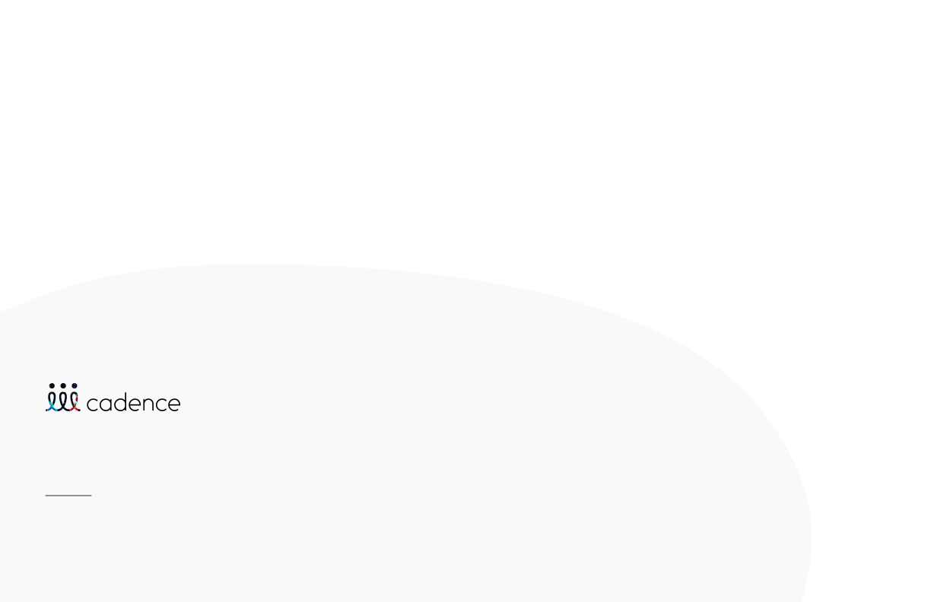
Sponsorship Guide 2023
As a sponsor at an event powered by Cadence, you have countless opportunities to secure a return on investment.

Slide 2
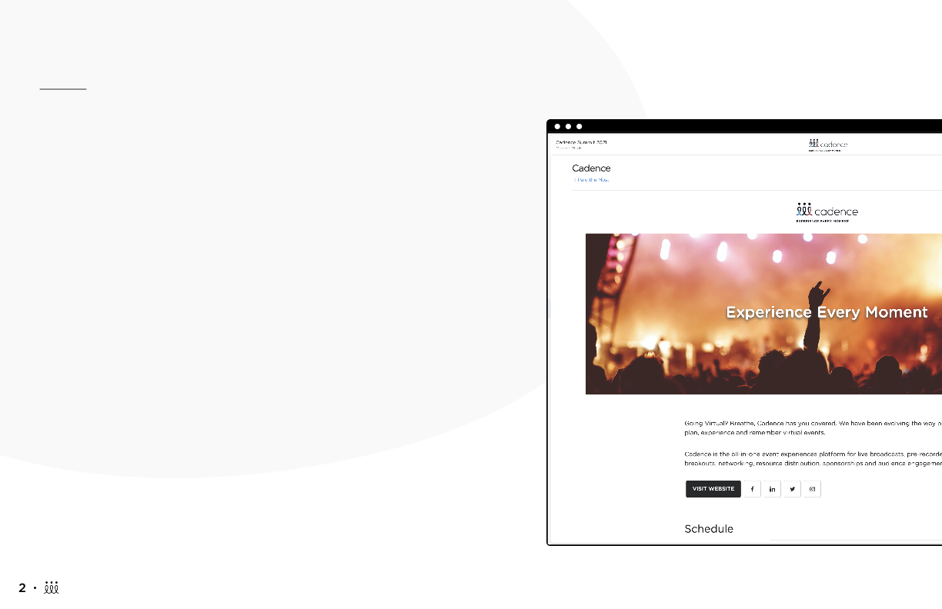
Brand Showroom
As a sponsor of an event powered by Cadence, you can create a unique company page/ virtual booth. It can be built out by the event organizer and you, the sponsor/vendor/partner.
Company pages can include:
Branding: logo, header image, tagline/slogan, inline video (coming soon)
Schedule items
Points of contact within the company
Messaging channels
Materials: videos, brochures, presentations, podcasts, surveys
Request an Appointment feature
Real-time visitor count (coming soon)

Slide 3
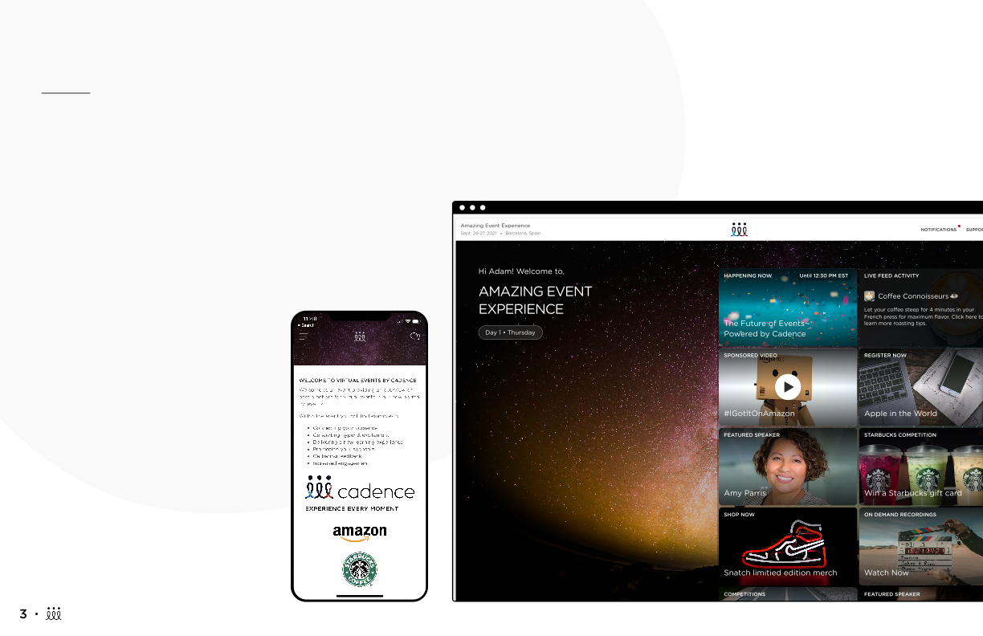
Home Screen Takeover
Your company can be featured on the main page of the overall event, so you’re the first thing attendees see.
Links to your company page for easy access
Image of your company logo on the Home screen
Home page sponsored video

Slide 4
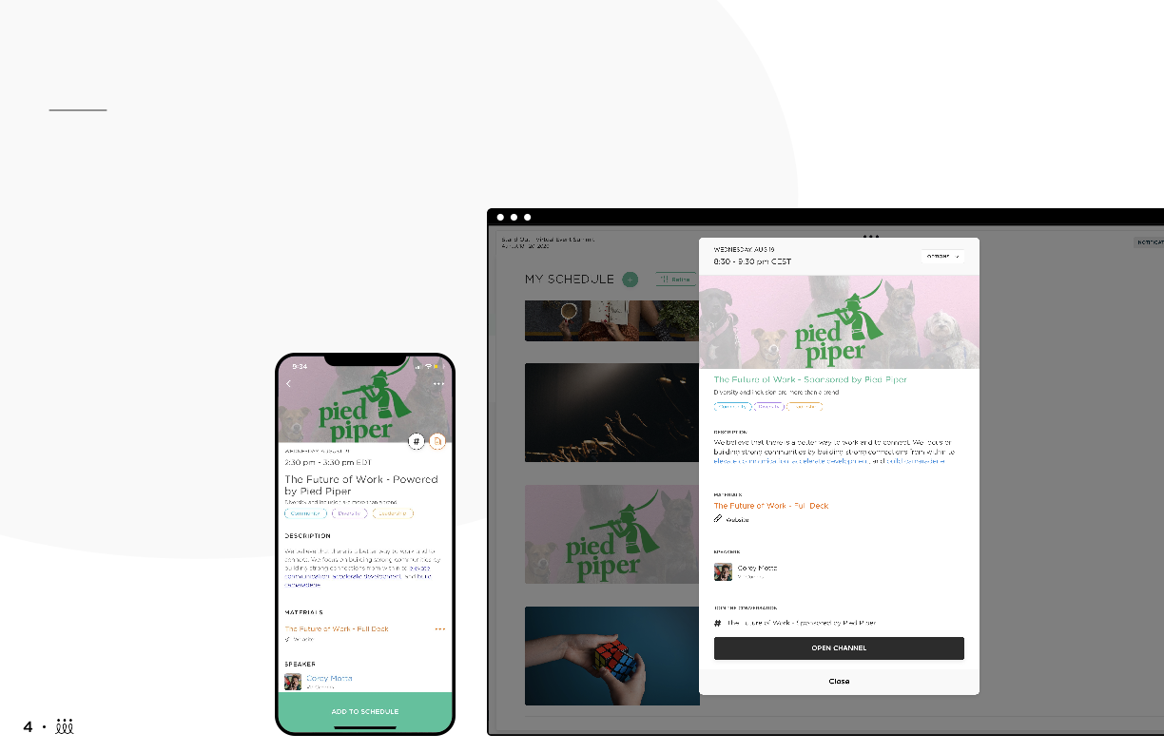
Sponsored Schedule Items
Your company can choose to sponsor a Schedule item that will help bring great visibility to your company. This can be for all attendees or an opt-in session.
Sponsored session ideas:
Q&A
Open forum
Presentation
Breakout sessions

Slide 5
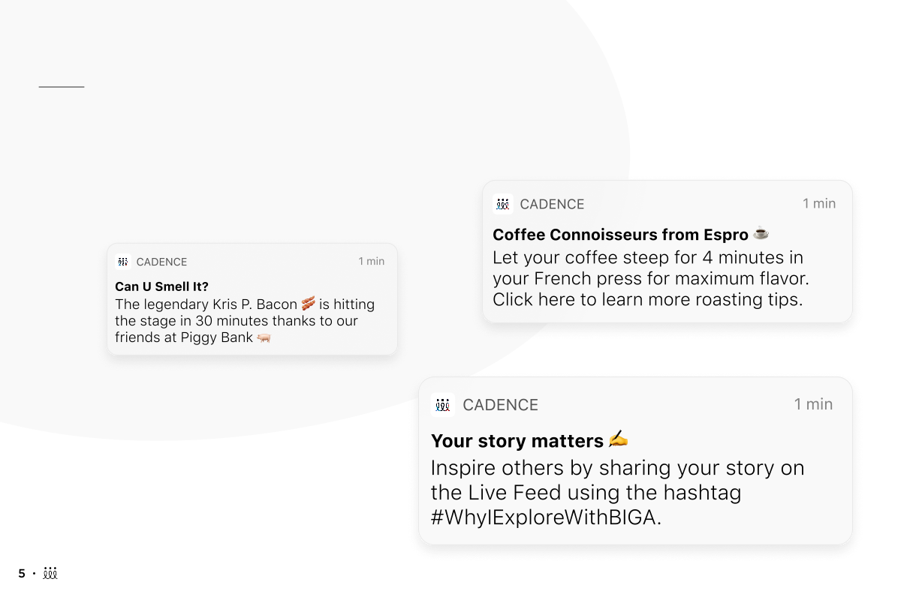
Sponsored Notifications
Sponsored Notifications can be extremely effective, as they are sent directly to all the attendees’ profiles. You can decide if this is a push-notification, email notification, or both. This could link to a session, competition, or directly to your company page.

Slide 6
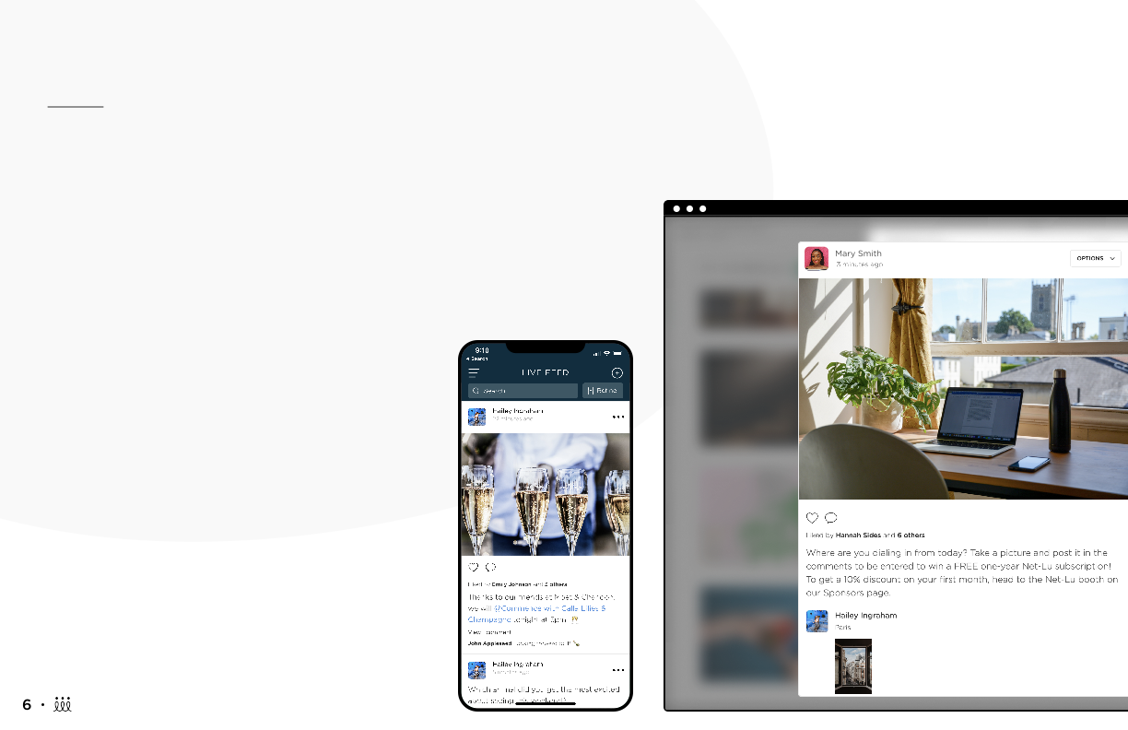
Sponsored Live Feed Posts
An active Live Feed makes for one fun, interactive event! So why wouldn't you want to contribute? You will have the ability to sponsor posts in Live Feed that can link to specific materials, your company page, or any schedule item.
Make sure it's a post that will be interactive for attendees. Ask them questions, encourage them to post pictures or GIFs, you could even make it a competition!

Slide 7
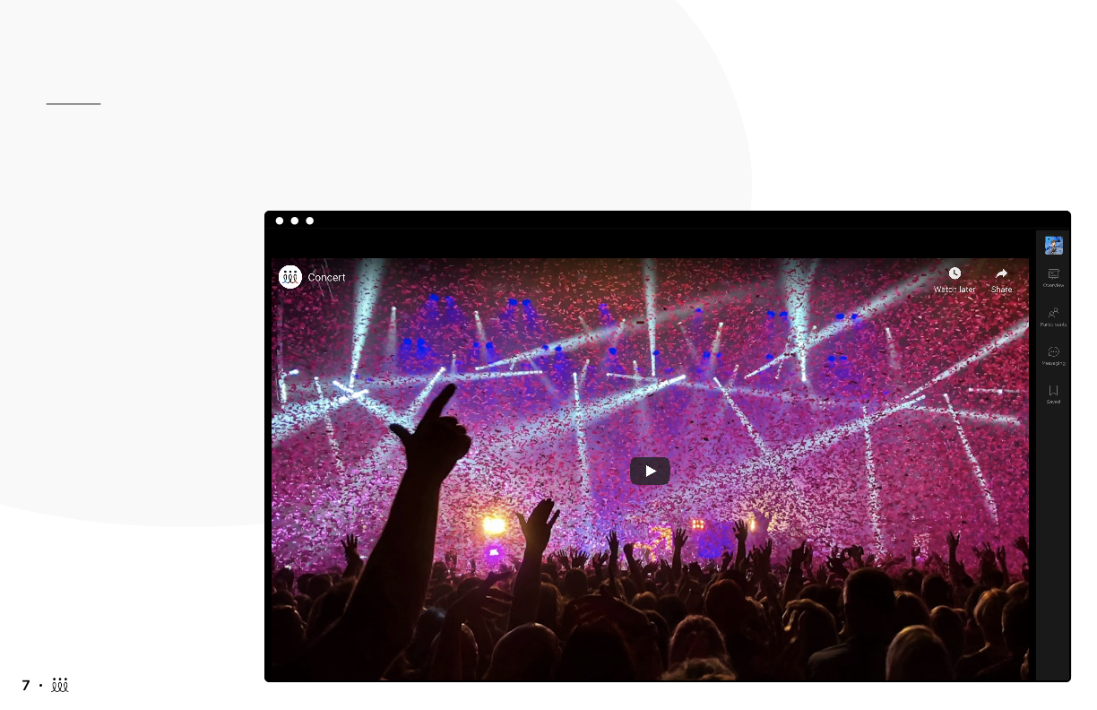
Video Ads & Interstitials
Video content is king right now. You could sponsor an embedded video banner (coming soon) or a video within a Symphony presentation.

Slide 8
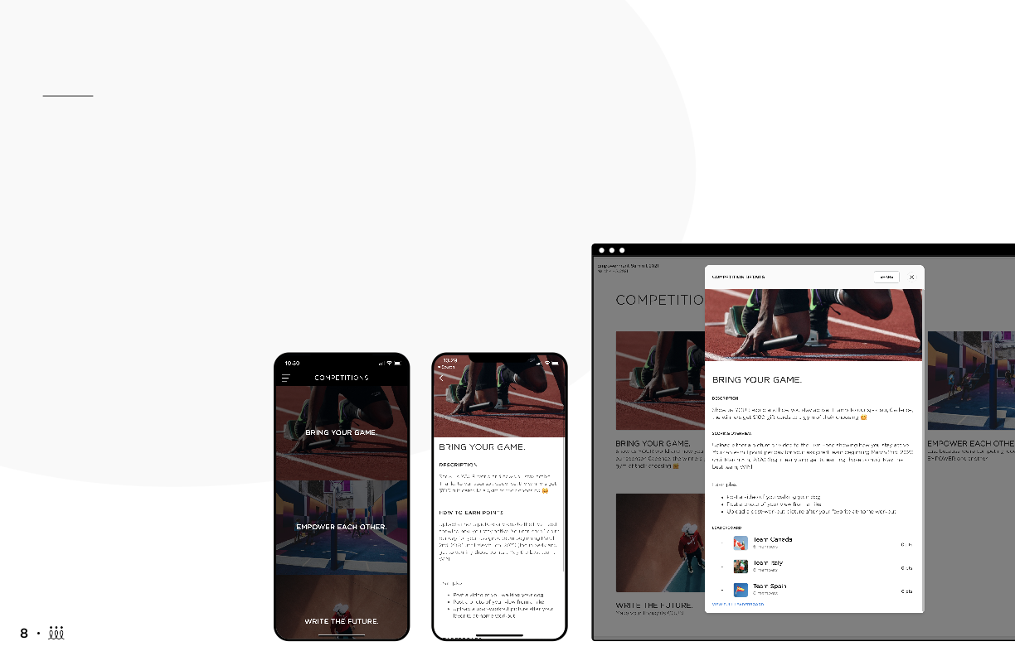
Sponsored Competitions
Competitions are a great way to get your audience excited and energized. They're also a great opportunity to give your company more visibility and engage with the audience. You can choose to team up with an event organizer to simply just sponsor a competition they're already committed to, or you could even create your own.
Different Types of Competitions offered in Cadence
Survey
Appointments
Live Feed engagement
Scavenger hunt
Custom

Slide 9
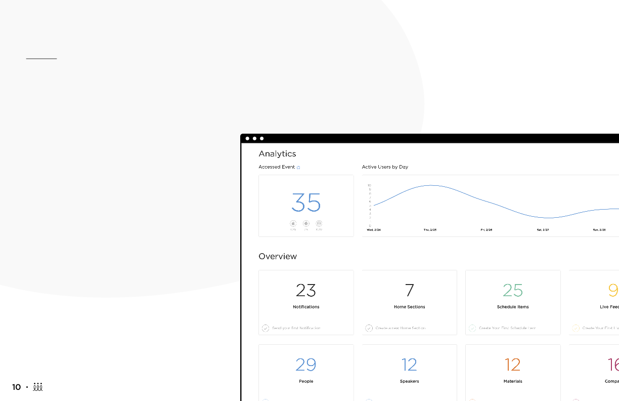
Return on Investment– Here you come!
One of the best parts about company pages is the reporting analytics. This is a great, tangible resource to see your return on investment. Plus, you will have all your leads' names & emails in one spot.
In the analytics dashboard, you can see how many people:
Visited your company’s page
Clicked links
Joined conversations
Made appointments
Consumed the resources

Slide 10
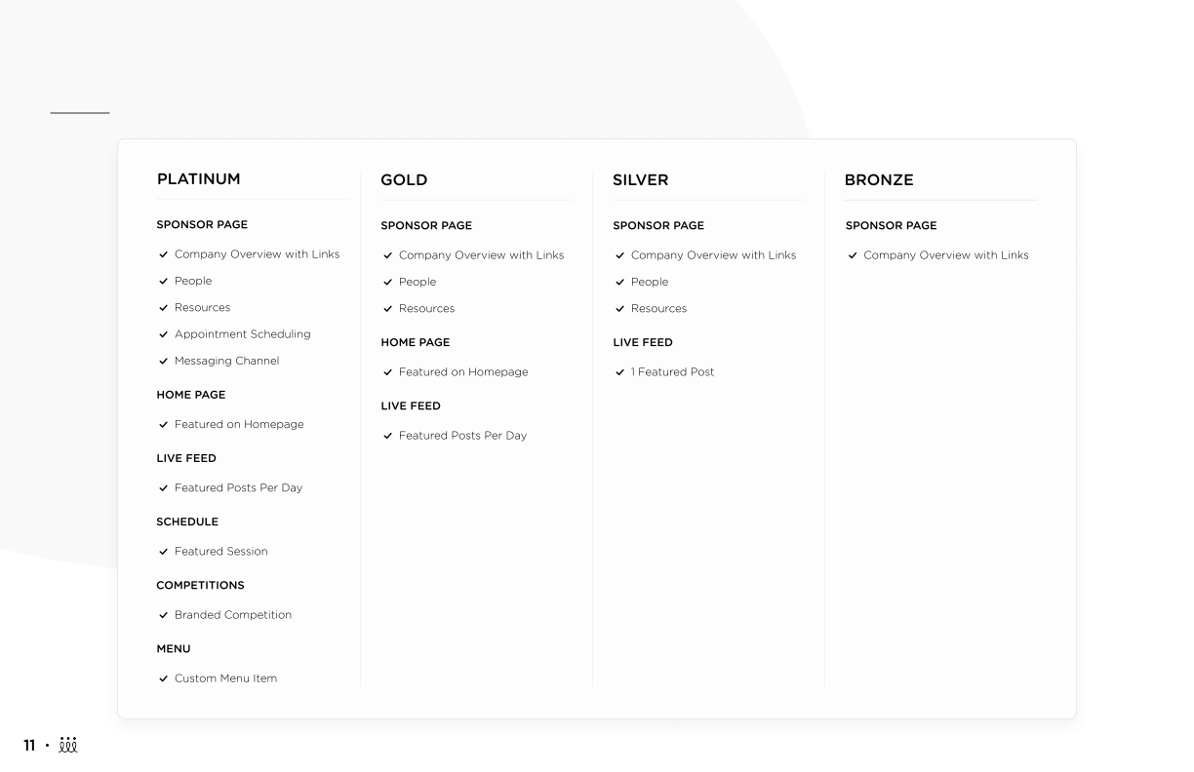
Recommended Sponsorship Tiers

