Slide 1


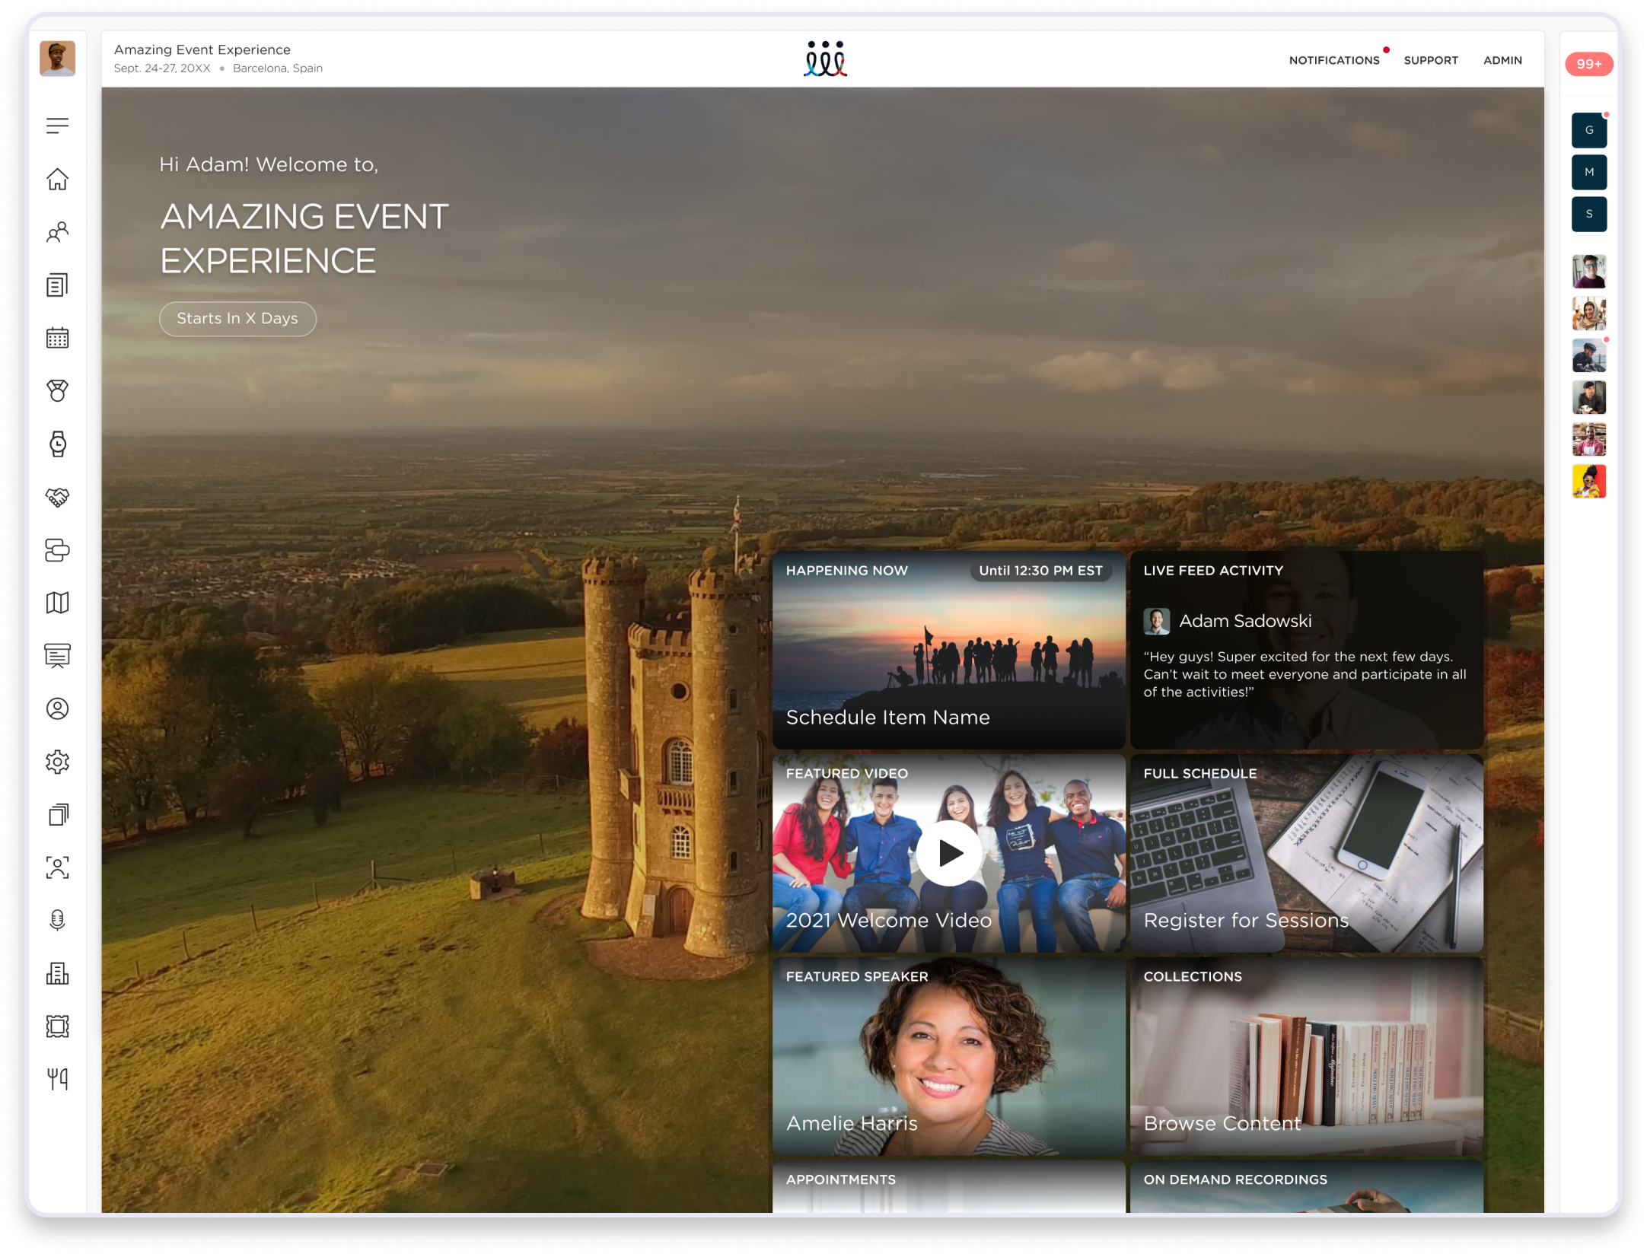



Attendee Experience Guide
How to use our guide in 3 simple steps:
Download PowerPoint
Once you download the PPT, you can customize the headers, descriptions, menu items, background, & platform images.
Edit Menu Icons
Use the last slide to copy and paste the menu icons that have been enabled for your event.
Send it out!
Delete this slide, save it, and start sending it out to your audience before the event.

Slide 2

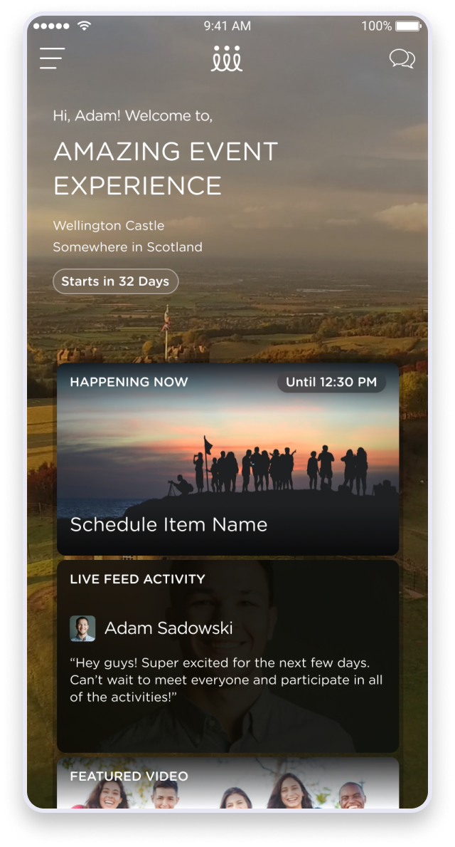


Attendee Experience Guide
A quick look at how to use the Cadence platform on your computer or mobile device
RECOMMENDED BROWSERS
Use Chrome or Firefox from a laptop or desktop with strong Wi-Fi for the best user experience.
DOWNLOAD MOBILE APP
Download Cadence from the App Store [Android / iOS] to use on your mobile phone.
LOST? TECH ISSUES?
Visit support.eventcadence.com to read support articles, best practices, or get in touch with the Cadence team.

Slide 3
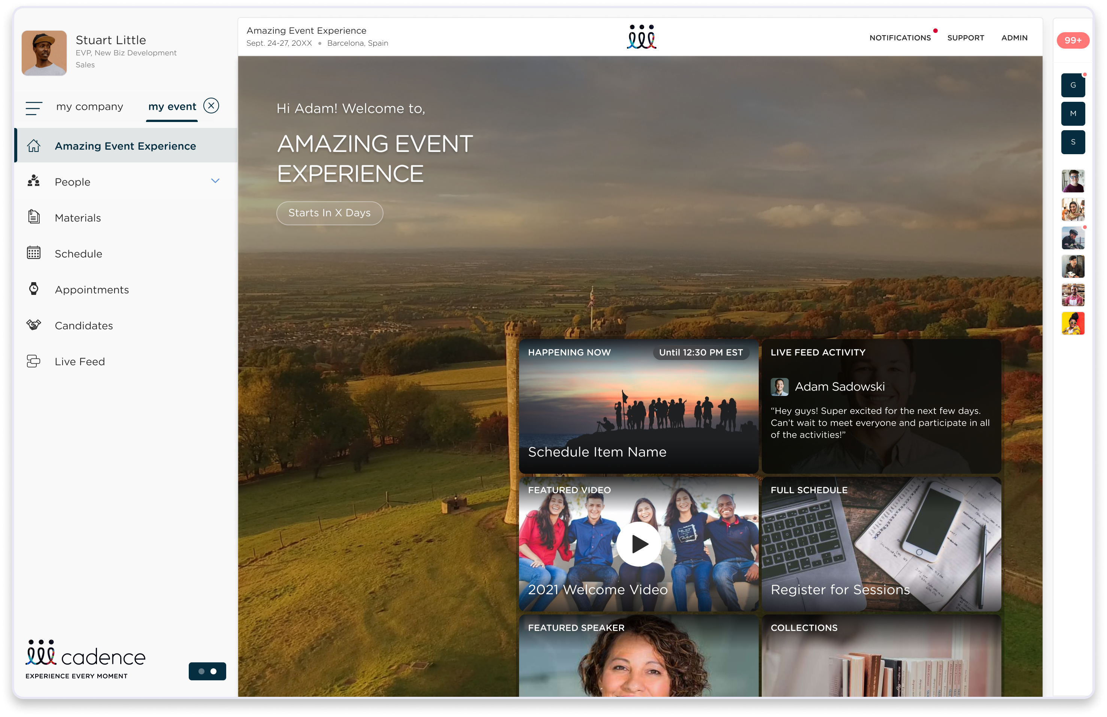








Navigating the Web
Accessing the available event features from the menu
Home
Speakers
Full overview of your event experience
Learn more about the speakers and connect with them
Schedule
Materials
See the full schedule with links to join virtual sessions
View and download the event’s materials
Live Feed
Companies
Start conversations and share photos, videos and GIFs of your favorite moments
Explore the sponsor’s offers and talk to their reps
People
Collections
Connect with other people based on mutual interests
View and download the event’s important materials

Slide 4
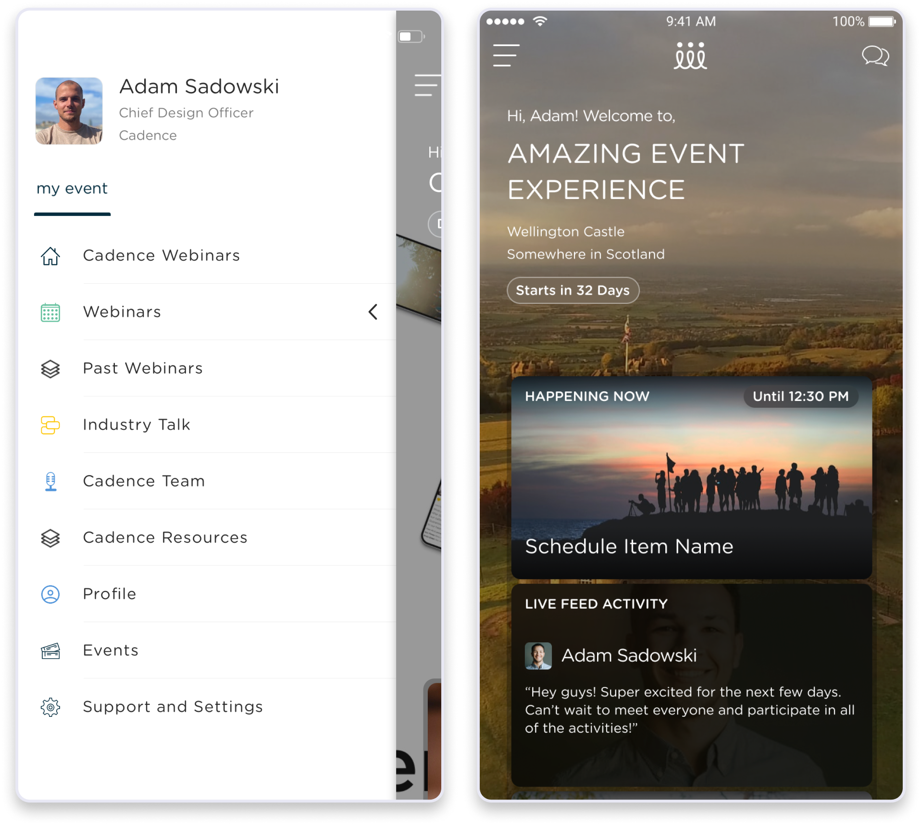
Navigating the Mobile App
Accessing the available event features from the menu
Home
Speakers
Full overview of your event experience
Learn more about the speakers and connect with them
Schedule
Materials
See the full schedule with links to join virtual sessions
View and download the event’s materials
Live Feed
Companies
Start conversations and share photos, videos and GIFs of your favorite moments
Explore the sponsor’s offers and talk to their reps
People
Collections
Connect with other people based on mutual interests
View and download the event’s important materials

Slide 5























Menu Items
When building the guide, copy and paste any menu items that have been enabled for the event
Home
Speakers
Compete
Custom
Full overview of your event experience
Learn more about the speakers and connect with them
Earn points and win amazing prizes!
Use this item as a template for any custom menu items
Schedule
Materials
Appointments
See the full schedule with links to join virtual sessions
View and download the event’s materials
See all of your appointments and view room availability
Live Feed
Companies
Customers
Start conversations and share photos, videos and GIFs of your favorite moments
Explore the sponsor’s offers and talk to their reps
See all of your customers information and appointment history
People
Collections
Leads
Connect with other people based on mutual interests
View and download the event’s important materials
See all of the leads your team captured at the event

